Slide 1
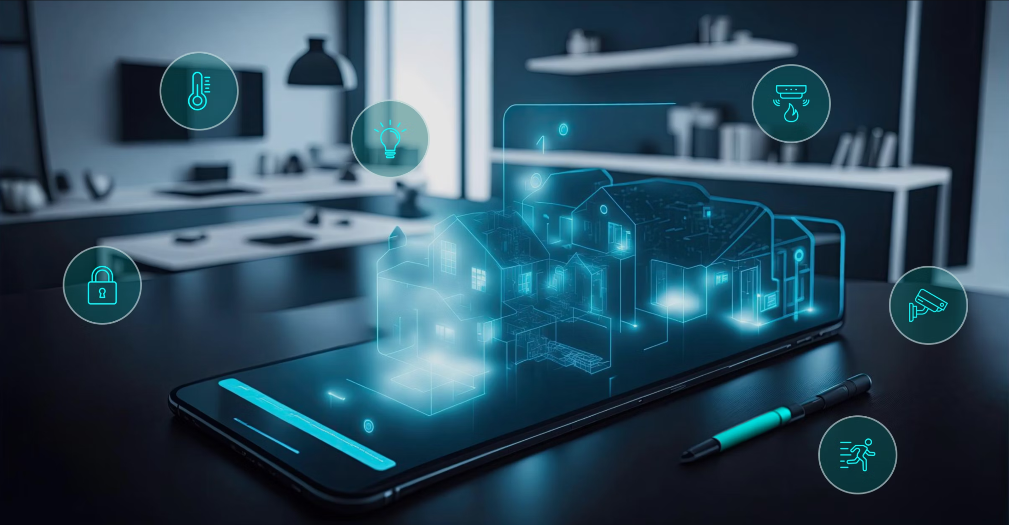

ECEN 404 Final Demonstration Team 61 - Smart Home Automation Nick Tool, Tyler Mayou, Matthew McLean TA: Fahrettin Ay Sponsor: Souryendu Das
Notes:
Michelle

Slide 2
Project Summary
The Problem: “Smart home systems are often composed of many different components from different companies. This can make it very difficult for a user to combine devices and implement a fully functional system for their own personal living or working space.”
Our Goal: “Develop a basic smart home automation system that allows users to control a few essential home appliances (like lights and speakers) via a mobile app and a simple web interface. The system will use non-IoT devices and a local server and online database.”
Notes:
Kyle

Slide 3
Project Summary
In our eyes, this project is meant to be built (integrated) into a new home. This would allow every device (light, speaker, thermostat, etc.) to be controlled from the mobile app/website.
This is a prototype showing control of a few devices (light, LED, speaker, temperature sensor). This project has the ability to expand beyond these devices with more R&D.
Notes:
Kyle

Slide 4
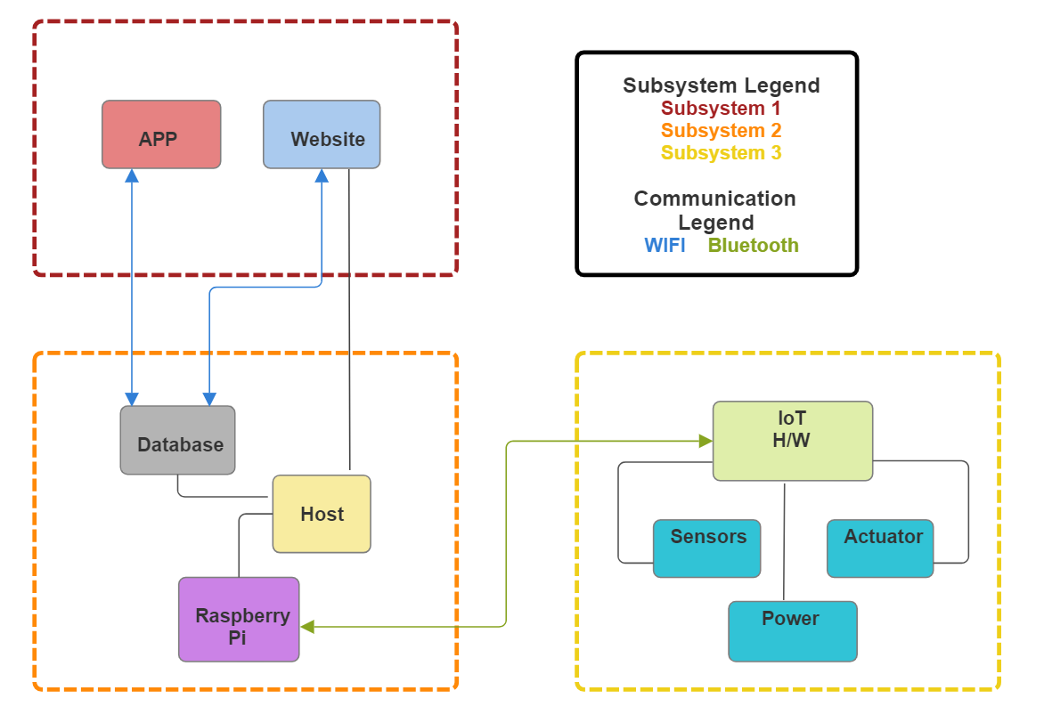
Project/Subsystem Overview
Matthew McLean
MQTT
Tyler Mayou
Nick Tool
Notes:
Eric

Slide 5
Assumptions
- This is meant to be a prototype system that would be integrated into your home.
Multiple users could control the devices on the same wifi
Hardware would be programmed to home wifi system.

Slide 6
Engineering Design Accomplishments
Designed Mobile and Web App Frontend
Kotlin for an android mobile app
HTML,CSS,JS,PHP for Web app
Both able to sign up, add devices, and control devices.
Both mobile and web app have been fully integrated with the server and database system
Challenges/Solutions:
Certain elements of UI are fully dependent on backend (adding devices) this makes testing go slowly when both front and backend are receiving updates at the same time.
Started last semester with no knowledge or experience with app development. I had to learn the languages and a lot about frontend and backend development.
More work needs to be done on error handling and edge case testing.

Slide 7
Engineering Design Accomplishments
MySQL | PHP | JavaScript
Table for user data with email verification, hashed password, etc. Mapped devices tables, dependent on user table and hardware constraints | HTTP requests to handle web interactions Backend API endpoints for web server Common reusable functions for different device types | Frontend API calls to backend endpoints Event Handlers on Frontend Preserving login details, user permissions and access points Communication with hardware through MQTT

Slide 8
Engineering Design Accomplishments
Dependencies:
Linux: Operating system
Apache: Serves web content
MariaDB: Database Management System
Ngrok: Creates tunnels to connect local traffic to internet
Mosquitto & Paho: MQTT Broker and Client
Challenges: Configuring dependencies to work together

Slide 9
Engineering Design Accomplishments
Designed IoT Hardware to control a few home devices
ESP32 as MCU: Using ESP-IDF on VSCode for programming
Power Supply: 5V 6A, powers both PCB and Raspberry PI
Devices: LED, light bulb/relay, mini speaker, and temperature sensor
Integrated with backend host using MQTT communication
Challenges/Solutions:
WiFi: Problems with TAMU-IoT WiFi, using personal hotspot
MQTT Communication: Initially tried HTTP requests, switched back to MQTT
Light Bulb: Initially tried AC dimming module, diverted to relay module

Slide 10
Engineering Design Accomplishments
Tested and Validated:
Device | LED | Light Bulb/Relay | Mini Speaker | Temperature Sensor (DHT11)
Testing/ Validation Results | On/off function Brightness function: 25% increment Controllable from Web App | On/off function Controllable from Web App | On/off function Volume function: 10% increment Controllable from Web App | Reads: Temperature in degrees Fahrenheit Humidity in percent
MQTT Communication | Subscribes to backend broker Receives message: topic/data Ex: “device/led” “LIGHT_ON” | Subscribes to backend broker Receives message: topic/data Ex: “device/relay” “LIGHT_OFF” | Subscribes to backend broker Receives message: topic/data Ex: “device/speaker” “SPEAKER_VOLUME:50” | *Still in testing Will publish payload to backend Ex: “device/thermo” “temperature:72”

Slide 11
Integrated System Results
2 Scenarios:
1: Getting home, you want to turn on the lights in your house and change the brightness.
2: Your house is quiet and you want to listen to some music.

Slide 12
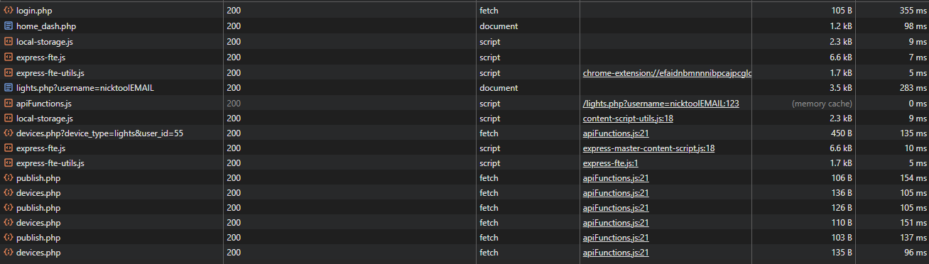
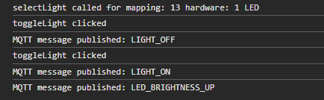
Integrated System Results

Slide 13
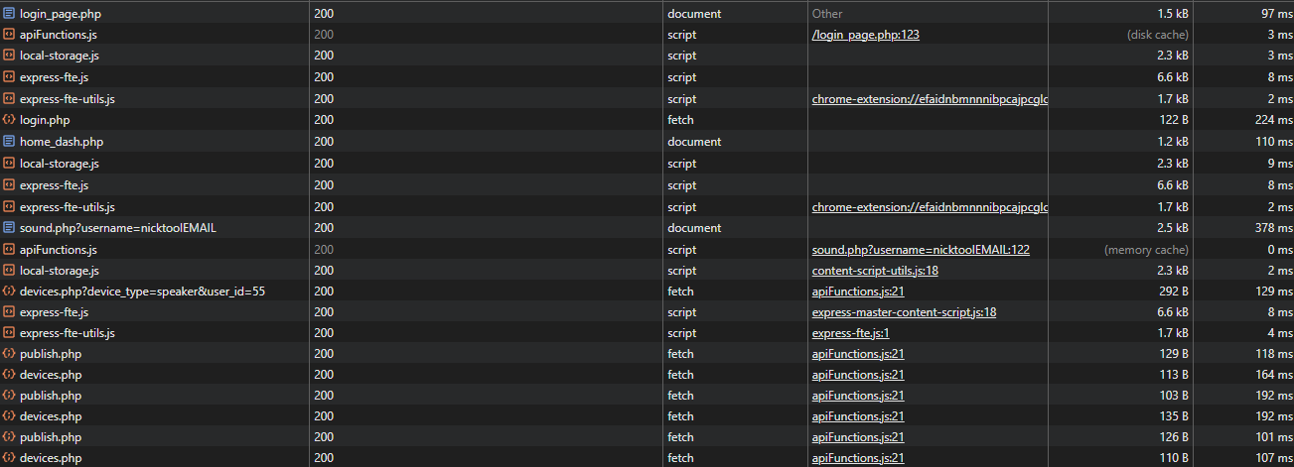

Integrated System Results

Slide 14
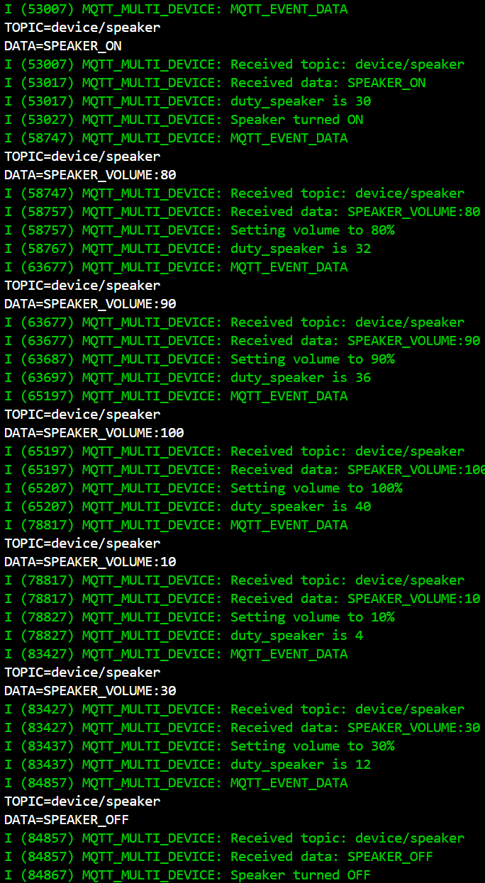
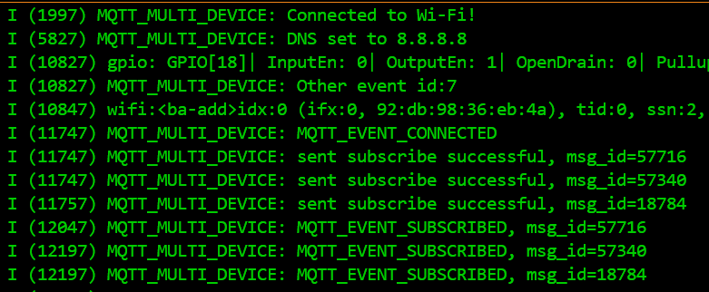
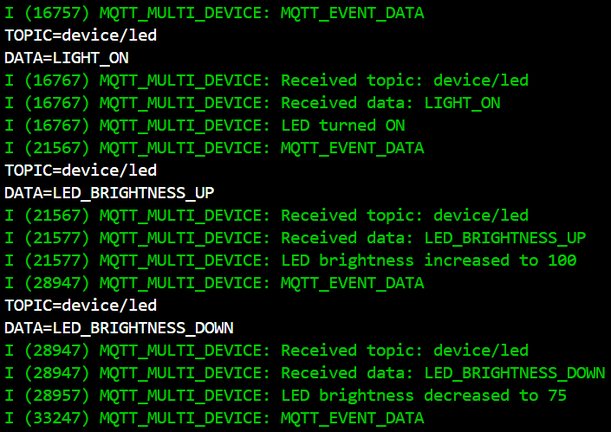
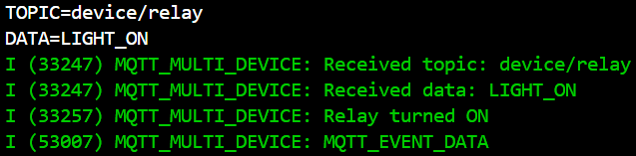
Integrated System Results
2.
1.

Slide 15
Thanks and Gig ‘em

